Slide 1

7.UART Temp Readings Using MSP 430 Launchpad
Goals: Introduce the students to UART communication using MSP 430 Launchpad

Slide 2
Data Transmission is two types
Parallel
Serial
1) Asynchronous
2) Synchronous

Slide 3
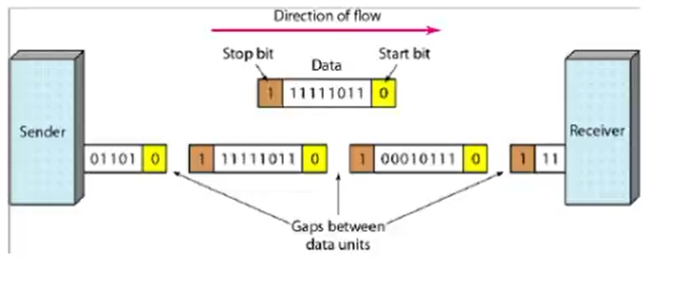
Asynchronous Communication
Microcontrollers (sender /receiver) need to convert their data on a parallel bus to and from a serial interface.

Slide 4
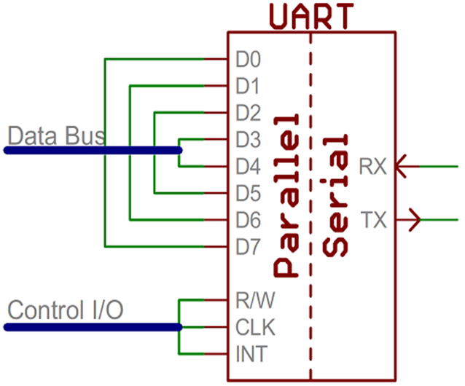
UART
Universal Asynchronous Receiver/Transmitter
• The UART takes bytes of data and transmits the individual bits in a
sequential fashion. At the destination, a second UART re-assembles the bits into complete bytes.
• 9600 8N1 - 9600 baud, 8 data bits, no parity, and 1 stop bit - is one of
the more commonly used serial protocols.

Slide 5
Interfacing
Data processing devices (or data terminal equipment, DTE) do not (usually) include data transmission facilities
• Need an interface called data circuit terminating equipment (DCE)
- e.g. modem, network interface controller (NIC)
• DCE communicates data and control info with
DTE
- Done over interchange circuits
- Clear interface standards require

Slide 6
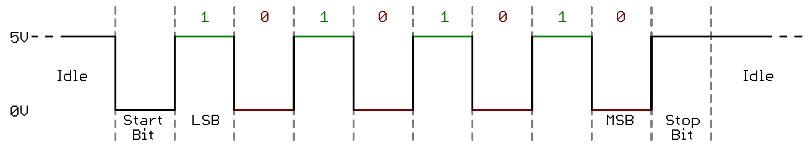
Serial Signaling
We use TTL ( Transistor-Transistor Logic ) level in serial communication.
Microcontrollers and other low-level ICs communicate serially they use TTL levels.
TTL serial signals exist between a microcontroller’s voltage supply range ( 0V to 3.3V or 5V).

Slide 7
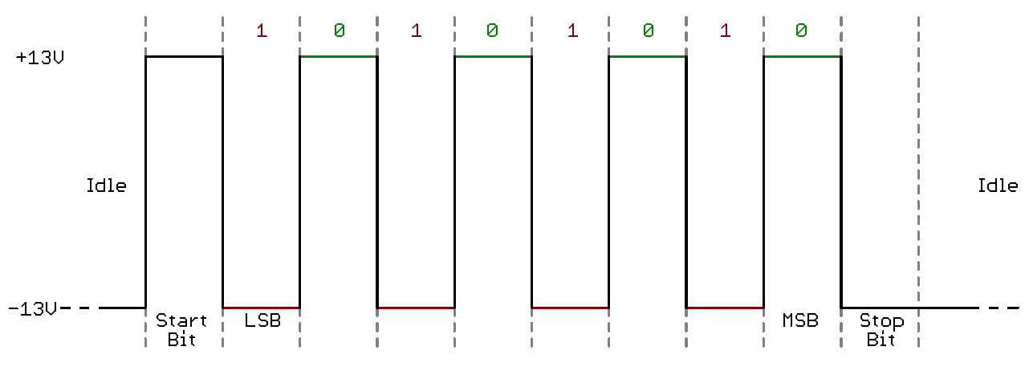
Serial Signaling
RS-232, USB
Like TTL serial flipped on its head.
Rs-232 signals usually range between -13V and 13V

Slide 8
Serial Signaling
TTL vs. RS-232
TTL is much easier to implement into embedded circuits. However, low voltage levels are more susceptible to losses across long transmission lines. RS-232, or more complex standards like RS-485, are better suited to long-range serial transmissions.

